Slide 1


EM algorithm and Gaussian Mixture Modelling for DNA methylation analysis
by
Siddhesh Jitendra Metkar
170106057
Supervisor
Prof. Anil Mukund Limaye
Dept. of BSBE
IIT Guwahati

Slide 2
Abstract
There is need to identify biomarkers for progressive complex diseases like cancer.
The identification of a consistent biomarker from comprehensive genome data is a huge problem.
The use of straight statistical measures can result in large false rates, especially in the context of quantitative data like DNA methylation.
We have implemented a statistical strategy that uses percentage methylation as the outcome variable for the analysis.

Slide 3
Objectives
To expand the novel models for the distribution of methylation proportions to select differentially methylated loci between cancers and regular subjects.
To advocate a classification method that differentiates tumor subtypes using DNA methylation profiles.
To increase laptop software programs or algorithms that implement techniques developed in particular ambitions 1-2.

Slide 4
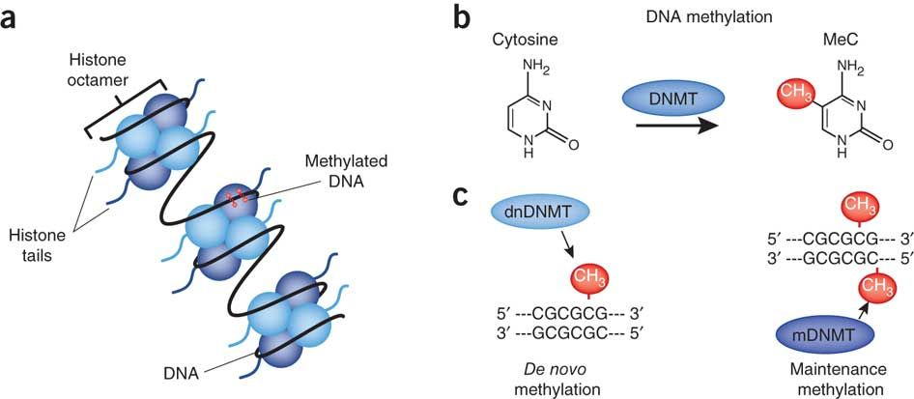
Epigenetic gene regulations:
Two major mechanisms
DNA Methylation
Histone modification

Slide 5
DNA methylation
DNA methylation is one of the most intensely studied epigenetic modifications in mammals.
In normal cells, it assures the proper regulation of gene expression and stable gene silencing.
DNA methylation is associated with histone modifications and the interplay of these epigenetic modifications is crucial to regulate the functioning of the genome by changing chromatin architecture.

Slide 6
DNA methylation
The covalent addition of a methyl group occurs generally in cytosine within CpG dinucleotides which are concentrated in large clusters called CpG islands.
NH2
NH2
CH3
N
Methyltransferase
N
O
N
O
N
~
~
cytosine
5-methylcytosine

Slide 7
Introduction
The primary purpose of this project is to discover the analogous problem of feature choice within the context of DNA methylation information.
DNA methylated CpG sites are quantified as u (unmethylated) and m (fully methylated).
We have implemented Maximum Likelihood Estimation (MLE) and Expectation Maximization (EM) Algorithm on the sequences.

Slide 8
Methods and Materials

Slide 9
Generating Sequences
We first generate of N number of sequences each having 10 CpG sites with probability that a site is methylated as ‘p’.
m = methylated site u = unmethylated site

Slide 10
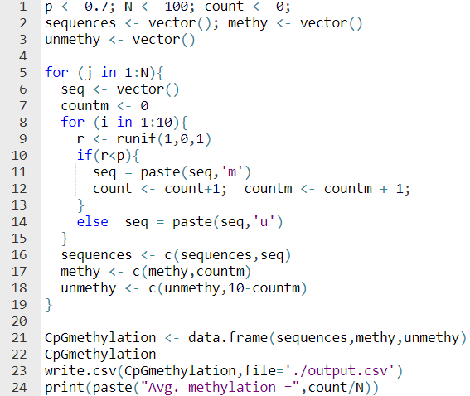
Code (R)

Slide 11
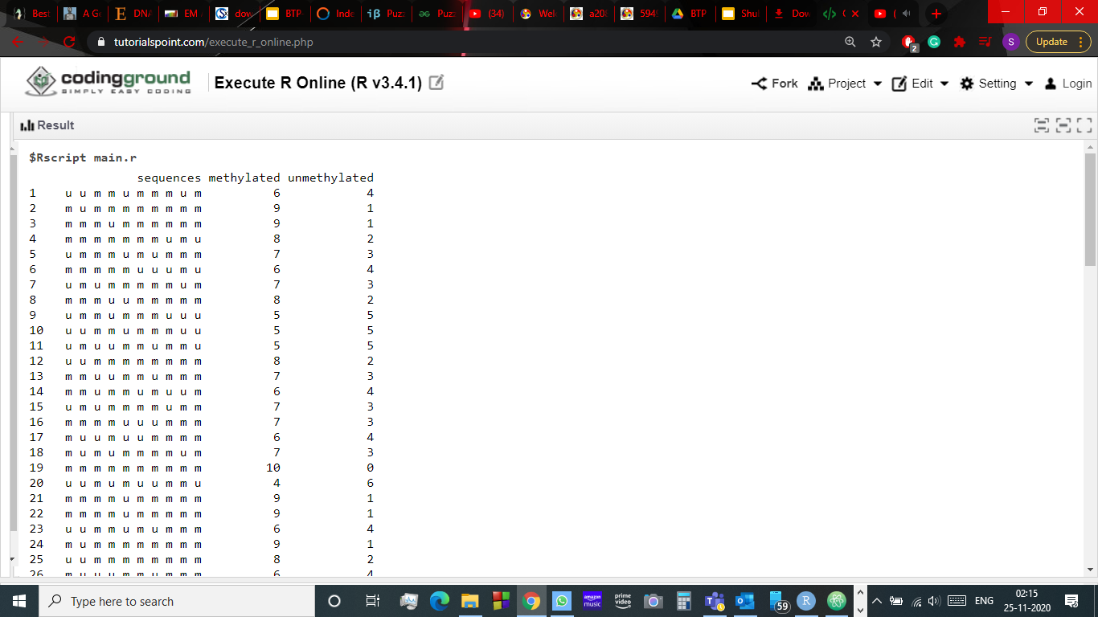
Output

Slide 12
Maximum Likelihood Estimation
MLE is a technique of estimating the parameters of a possibility distribution by maximizing a probability function, so that under the assumed statistical version the found information is maximumly probable.
Equation of single variable linear regression is
Y = B₀ + B₁X.
Unlike, Least Square Fit method, MLE is used to estimate the parameters B₀ and B₁ based on our observations.

Slide 13
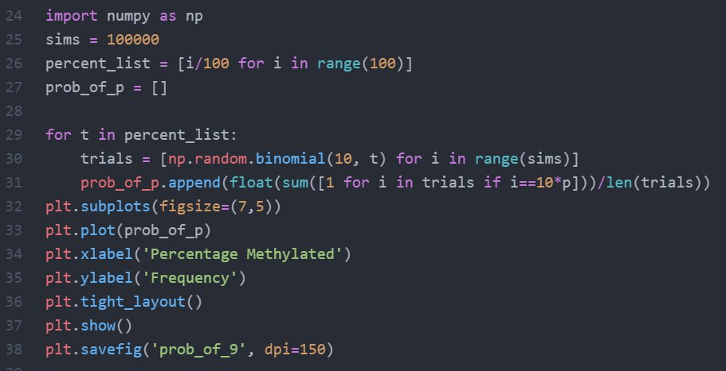
Code (Python)

Slide 14
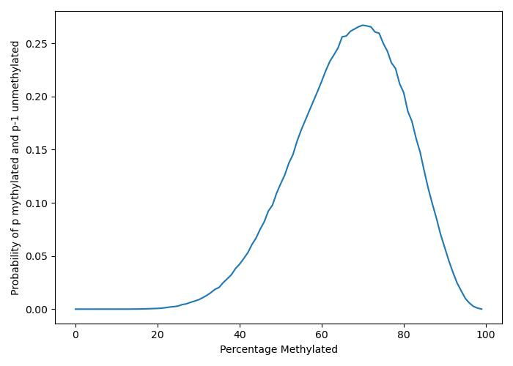
Output: For, p = 0.7

Slide 15
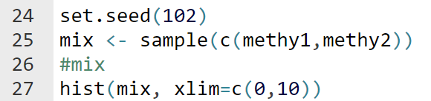
Shuffling of sequences
Mix 2 group of sequences with probabilities p1 = 0.2 and p2 = 0.7 and plot histogram.
Code(R)

Slide 16
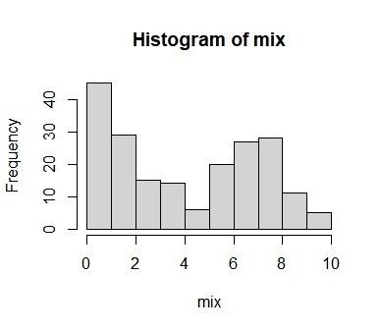
Output: for p1 = 0.7 and p2 = 0.2

Slide 17
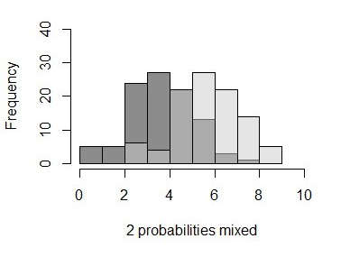
Output: for p1 = 0.6 and p2 = 0.4

Slide 18
EM algorithm
Expectation-Maximization algorithm is an iterative algorithm that cycles between two steps.
The Estimation(E) - step creates a log-likelihood expectation function using current estimated parameters.
The Maximization(M) - step maximizes the likelihood based on parameters in E-step.
This algorithm was implemented on the mixture of methylation probabilities 0.2 and 0.7 and the probability distribution of the obtained mean and variance for two gaussians was generated.

Slide 19
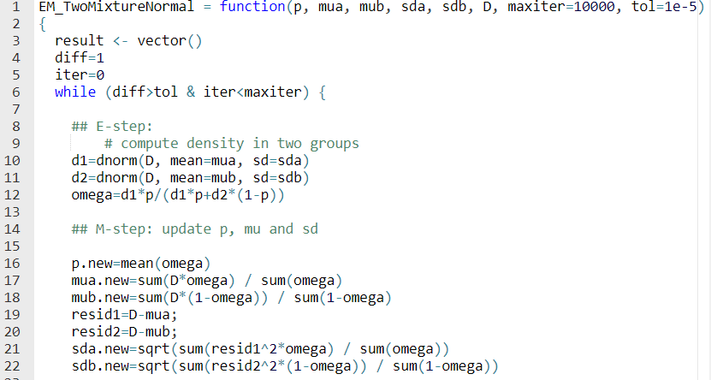
Code (R)

Slide 20
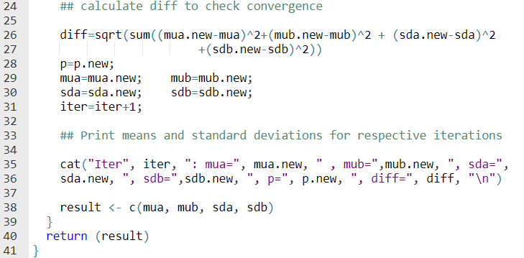

Slide 21
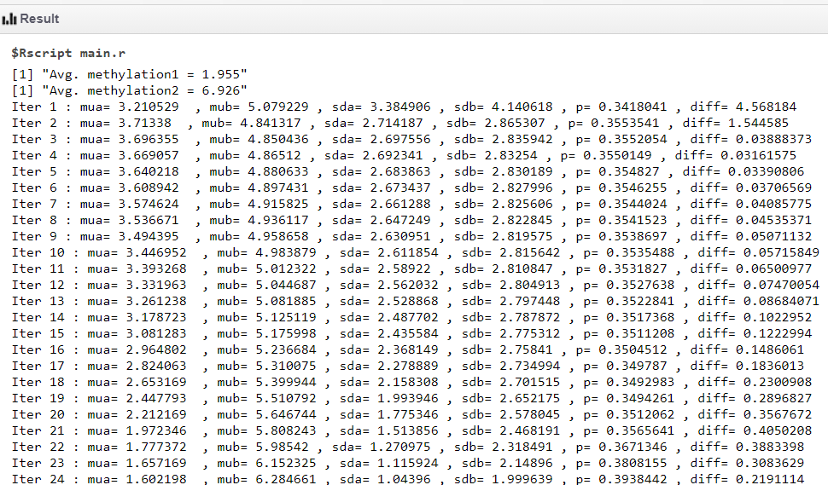
Output: For, p1 = 0.7 and p2 = 0.2

Slide 22
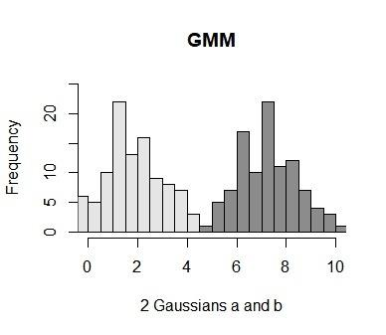
Output: For, p1 = 0.7 and p2 = 0.2

Slide 23
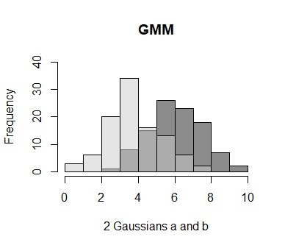
Output: For, p1 = 0.6 and p2 = 0.4

Slide 24
Results
EM algo. on mixture of methylated probabilities 0.2 and 0.7.
When 100 sequences for each probability were mixed with initial mean values set as 0.1 and 0.9 for the two gaussians, the output was generated in 59 iterations.
The means of the two gaussians in the output were 1.955 and 6.926 which is very close to the desired output of 2 and 7 respectively.

Slide 25
Conclusions
This method allows the integrative evaluation of CpG sites with experimental parameters and datasets.
The algorithm provides accurate estimates of CpG site modifications even in some confounding datasets.

Slide 26
Conclusions
For the reason that DNA methylation biomarkers for improved diagnosis and/or early detection of cancers are probable to be characterized by means of small impact sizes, it's far crucial to have powerful statistical algorithms in the vicinity that can assist discern true from false positives.

Slide 27
Thank You

